Slide 1
Hall A Tritium Target Status
Dave Meekins
18 January 2017

Slide 2
Overview
Intro
Subsystem Status
Cells
Shipping
Exhaust
Beamline
Cryo-System
Controls/Safety
Administration
Summary

Slide 3
Information and Documentation
New wiki for the tritium target:
https://wiki.jlab.org/jlab_tritium_target_wiki/index.php/Main_Page
Reports: design and technical
Drawings
Procedures
Calculations
Presentations
Review
Presentations, Responses, Committee reports

Slide 4
Target Ladder
5 Cells:
T2,H2,D2,He3,MT
Optics
Dummy/alignment
Solid
BeO, C-hole, C,
Heat sink cooled by ESR to 40K
Stabilized by heater

Slide 5
Tritium Target Final Ladder
Target | Total Solid Thickness | Fluid Thickness
Tritium Cell | 0.16 g/cm² | 0.075 g/cm²
Helium 3 Cell | 0.16 g/cm² | 0.075 g/cm²
Deuterium Cell | 0.16 g/cm² | 0.12 g/cm²
Empty Cell | 0.16 g/cm² | N/A
Hydrogen Cell | 0.16 g/cm² | 0.05 g/cm²
Aluminum Dummy | 0.3 g/cm² | N/A
Carbon Optics | 0.2 g/cm² | N/A
Carbon Foil | 0.167 g/cm² | N/A
Carbon Hole | 0.167 g/cm² | N/A
Thick Aluminum | 1.37g/cm² | N/A
BeO | 0.16 g/cm² | N/A
Be Isolation window | 0.04 g/cm² | N/A

Slide 6
Target Cell
Main Body and Entrance Window
ASTM B209 AL 7075-T651
Valve assy:
SST 316 and 304
1090 Ci of T2 (0.1 g)
~200 psi at 295K
25 cm long
ID of 12.7mm
Volume = 34 cc
Aluminum CF seals

Slide 7
Cell Cross Section
0.018” wall

Slide 8
Operational Limits
Beam Current
$I_{max}=20 μA on T2 cell$ 25 µA on all others
Raster
2x2 mm minimum
Beam Trip limit (18000 trips)
Temperature
Heat sink must be ~40K
Target Operator 24/7 when cold
Tritium effects access procedures and training requirements

Slide 9
Tritium Compatibility Study
Tritium and Hydrogen Compatibility
Extensive experience with H2
Beam induced corrosion not expected below 180K (Flower et. al.)
Beam assisted embrittlement
$T_{2}→T+T$ Increases fugacity
Atomic tritium recombines rapidly
Modeled room fugacity ~3100 psi
Below threshold for H2 embrittlement
Many orders of magnitude below He-3 swelling threshold (Louthan)
Test SRNL/SRTE using precracked coupons exposed to 2500 psi T2 complete
Test follows ASTM 1820 G168 (Precracked Stress Corrosion Testing)
Samples exposed for 4, 8, 12 months
M. Morgan, A. Duncan (SRNL)
No measurable effects observed

Slide 10
Current Status
Six acceptable cells have been fabricated
One complete assembly (including shipping covers etc.) is at SRS
Used for training and mockup
One cell to be used for Argon experiment in Spring
Fabricating 2 more
Cell
Accepted by JLAB review
ERR Sept 2015
Accepted by SRS review
Safety Basis October 2016
Status (100% Complete)
We have enough to run with no spares

Slide 11
Exhaust System
36” OD 20m tall Stack
12000 cfm blower multispeed
2” pump exhaust
Run parallel to stack
Stack must also serve as smoke removal
Provides controlled release of secondary and tertiary containment
Pump exhaust is continuous
Blower activated:
Manual
Interlocks

Slide 12
Exhaust Routing

Slide 13
Stack Base and Blower

Slide 14
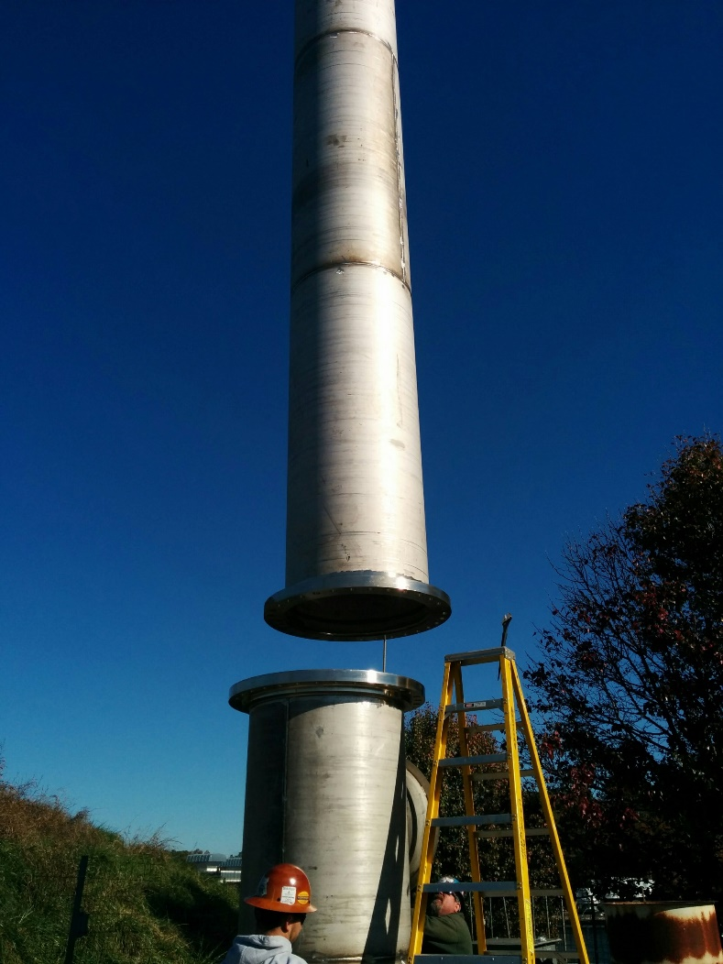
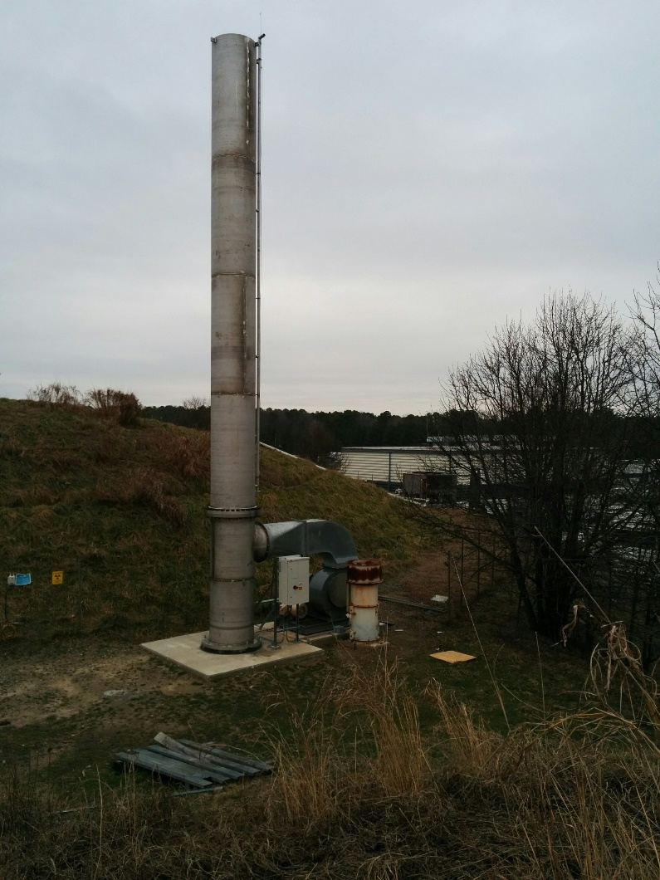
Stack lift/assembly

Slide 15
Internal Exhaust

Slide 16
External Components
Stack (Complete)
50 ft above Hall A Dome access (20 m above grade at site boundary)
Applicable Codes and Standards
ASME STS-1 (2011)
ASCE-7 (2010)
UL-96
JLAB SE approval
Blower (90% Complete)
12000 SCFM blower variable speed (VFD)
Applicable Standards
JLAB FPE Approval
Not connected to Hall port at this time
Pump Exhaust (80% Complete)
Vacuum pump exhaust parallel to stack
Not connected to Hall port at this time

Slide 17
Internal Components
Handling Hut (100% Complete)
Platform (90% complete)
Needs fitting
Installed only for Cell installation/removal
Ductwork/Damper (99% Complete)
Truck Ramp Door Control (99% Complete)
Limited to very small number of individuals
Cans Access (100% Complete)
Fan Controls (75% Complete)

Slide 18
Beamline Alterations
No plans to substantially alter beamline
Upstream beamline shall be isolated by a Be window
0.008” thick 1” ID.
Water cooled (3W beam power 25 µA)
Reentrant (Resides in chamber)
Downstream beamline to be isolated if effects to the physics are not unacceptable
Window is 15 cm from entrance to cell
Densimet collimator 10 cm long installed in tube upstream of window. (W 90% , Cu 8%, Ni 2%)
Maintenance is possible if required.
12 mm thick collimator attached to cells
Collimators should prevent steering error from affecting cell
Last steering element is 8 m upstream and 2” radius beam pipe.
Status (30% Complete)
Collimators have not been fabricated

Slide 19
Be Isolation Window
0.008” Be window
Cooled by self contained water chiller to 10C
Integrated collimator Densimet

Slide 20
Cryo-System
ESR 15K He for cooling
Must return ~25K
PID Control heater
40K
Return mixed with bypass.
Bypass valve on PID
Alarms/interlocks on TS-5 (a/b) and TS-6 (a/b)
Similar controls to Cryotarget
Status 20% Complete

Slide 21
Shipping
T2 is flammable and radioactive
Applicable regulations come from both DOT and NRC/DOE
Cell is supported in custom carrier rack
Rack is installed in MTV
Miscellaneous Tritium Vessel
MTV is shipped in BTSP
BTSP = Bulk Tritium Shipping Package
Approval to use
BTSP/MTV granted in July 2017
JLAB T2 was to be first to use MTV

Slide 22
Carrier Rack/Cell Assembly
Completed Rack Assembly used for testing/training
Specific Procedures to use Rack/MTV are under development

Slide 23
Controls and Safety Systems
Control System Similar to Hall A Cryo-Target Controls
Numerous FSDs/Alarms
Tritium Monitors
On loan from SRS/SRTE
Handheld and Remote
Remote air suction tubing has been installed
T2 monitors are being integrated into controls
Monitors will issue FSD and activate exhaust system
Software is under development
Bio Screening program has been initiated
Limited number of participants

Slide 25
Exhaust System Activation

Slide 26
Vacuum Fault System
FSD issued on all faults
Getter operates on cold cathode failure
Pressure switch closes main turbo valves
Flow switch on water cooling for Be window
All faults trip alarms on UI
Pressure events trip heater power.

Slide 27
Administration
Reviews
ERR Preliminary Design June 2010: Produced more than 50 action items
ERR Design Review September 2015: Positive comments design considered acceptable
ERR Experimental Review March 2016: Addressed issues from September adequately
ERR Final Review for implementation/walkthrough: Needs to happen near the start of the experiment
SRS Safety Basis for filling completed June 2016
SRS Safety basis for shipping March 2017
Facilities Review and Coordination April 2016
DOE MTV/BTSP Approval July 2017
DOE NNSA Approval for T2 transfer December 2016
DOE NEPA Approval August 2016

Slide 28
Summary
All reviews are nearly complete
Control and Cryo systems are under development
Moved to lower priority with new schedule
Exhaust system is nearly complete
Shipping issues have been resolved
Safety systems are nearly complete currently testing
Cells are complete
Working on Spares now
Most administrative tasks are complete
Target should be ready for Fall 2017 run

Slide 29
Materials-2
Al 7075 is unlisted
Design basis
$S­_{ut}=72 ksi$
$S_{y}=61 ksi$
$S_{a}=\min\left(\frac{1}{3}S_{ut},\frac{2}{3}S_{y}\right)=24 ksi$ for tension
= 80% of 24 ksi for shear
= 150% OF 24 ksi bending
Other wetted materials are SST
304/304L
316/316L
ER316L Filler for welds

Slide 30
Load Conditions
At room temp
P = 200 psi
At 40K Beam Off
Pressure = ~30 psi
Max Temperature = 40K
Beam On
Pressure = 36 psi (avg temp of T2 = 53K)
Max Temperature = ~125K
Cyclic loads
Cool down/warm up operating cycles = 20
17800 beam trips (cycles between Beam On and Off)
150 days, 33% duty factor, 15 trips/hr

Slide 31
Analysis
Applicable Code ASME B31.3 (2014)
Section 304.7.2 because of odd geometry
Used both Hand Calculations and FEA
Analysis conforming to ASME BPVC VIII D2 with load factors from B31.3 (i.e. 3 instead of 2.4 on P)
Used cyclic screening analysis from D2
Depth of loads do not require a fatigue analysis
175 psi pressure cycle (it is closer to 10 psi)
Considers temperature cycle from 40K to 125K
Design pressure 675 psi
No source of overpressure
Calculations: TGT-CALC-103-002, 7, 8, 12, 13, 14, 15, 17.

Slide 32
Thermo-Mechanical Model-1
Full temperature load
Beam on at 20 µA 2x2 mm raster
Pressure load 400 psi internal (more than 10x)
Cooling using 40K heat sink
Using an elastic-plastic model
Model solves and stresses are still below allowable even for over conservative case
Local plastic failure requirements met
Analysis not required because of screening analysis

Slide 33
Thermo-Mechanical Model-2

Slide 34
Thermo-Mechanical Model-3

Slide 35
Mech Therm Model of Raster Off

Slide 36
Raster Off Time Dependence

Slide 37
Density Model
T2 properties derived from H2
Viscosity, Thermal Conductivity, Heat Capacity, etc.
Assumed a Real Gas model
Buoyancy, convection on wall included
Assumed fixed 2.8W from 20 µA and 2x2 mm raster (11 mW/mm linear power density)
Did not correct heat load for density
Averaged 20% reduction in density along beam path

Slide 38
Vacuum System
Scattering chamber (standard Hall A)
1900 liters
Thin sections for recoil particles (0.014” aluminum)
Two 800 l/s turbos backed by Leybold D60 Mech pump
NEG Pump with backing turbo and mech pumps
Vacuum exhaust part of Tritium Exhaust System and is continuously purged with N2 (1 cfm)
Isolated from upstream beamline vacuum (Be window)
Remote RGA may help diagnose leaks. Serve as leak detector.

Slide 40
Materials
Main Body and Entrance
Aluminum 7075-T651 ASTM B209
Extensive use of this allow for 15 years
Strong, ductile, hard, non weldable
Seals are Al 1100
Valve assembly
SST 304/304L Fitting
Swagelok valve all metal bellows sealed (316L)
Butt welded ER316L (100% VT in process and RT)

Slide 41
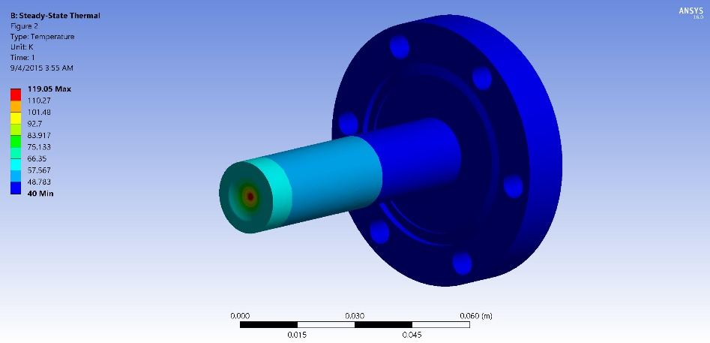
Beam Heating
$I_{beam}=20μA$ Max beam current $A_{raster}=2x2mm^{2}$ min raster
3W in Entrance
3.3 W in Exit
$T_{max}=125K$ on exit $T_{max}=120K$ on entrance

Slide 42
Summary of Test Results
Multiple hydrotests on components and assemblies
Entrance: Minimum burst above 2900 psi
Main body: Minimum burst above 3400 psi (0.014” section)
Assembly with covers
Leaked above 4000 psi (seal was damaged)
Failed above 5500 psi

Slide 43
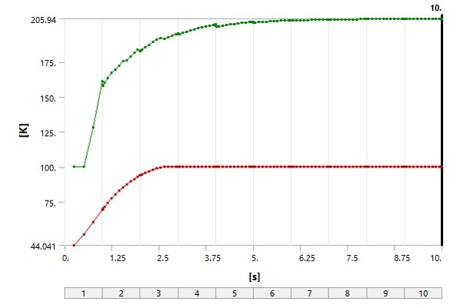
Raster Off
Initial conditions:
Beam on full raster
20 microA
Exit window is worst case
Beam spot no raster
0.150 mm diameter
Square profile
For high energy beam this spot size is very conservative
Tune shall be checked at each energy
Long term operations at these conditions are forbidden
Typical FSD for raster failure
< 10 ms
Red curve is upstream section temperature

Slide 44
General Requirements
Collect T2 from any release inside Hall A and exhaust in a controlled fashion
Exhaust point shall be 20 m above grade at site boundary
Must serve as part of the smoke removal system (at least 1/3 of the 36000 cfm required)
Must have at least two modes to service hut and to exhaust from Hall A. (500 and 12000 cfm)
Must stack vacuum pump exhaust
Scattering chamber, dump line, getter system
Makeup air comes from new louvered door at bottom of ramp.
Prevents overpressure on ramp door.
Test required for louver system
Air from outside from smoke removal system on ramp with damper removed

Slide 45
Exhaust Summary
Exhausts secondary (vacuum chamber) and tertiary (Hall A) containment to 20 m stack
Two speed
~500 cfm
12000 cfm
Exhaust system activated
Vacuum switch failure (interlock)
Truck ramp lower door (interlock)
Manual activation (Hall and Counting House) (manual)
Low speed activated manually for hut (manual)
T2 monitor (interlock)

Slide 46
Status
Successful review on 15 September 2015
Report available on wiki
Pressure system calculations reviewed by 2/1/2016
Final ladder assembly fixed by 3/1/2016
ERR 3/16/2016
Design of platform complete
Construction of handling hut complete
Cell design and prototyping/testing complete
Fabrication underway for actual cells
Modifications to Qweak target underway
Cryo sytem/piping ~50% complete
Material testing is underway at SRS/SRTE/SRNL
Working through unresolved issues regarding shipping
NEPA analysis is complete should be presented to our site office by 2/1/2016

Slide 47
Schedule
Hut and Platform
Fabrication complete by 3/1/2016
Test install June 2016
T2 Exhaust system
Internal vent install April 2016
External May and June 2016
Target
Complete modifications to Qweak 3/1/2016
Assembly complete 8/1/2016
T2 cell install 10/1/2016
Interlocks
Checkout complete 8/30/2016
ERR 3/16/2016
Checkout review 9/1/2016
Dates are estimates

